Slide 1
Things You Should Know About Economic Development
Lynn A. Knight, CEcD
Notes:
Notice: Please do not repurpose these slides without permission from DRA and IEDC

Slide 2
Why this workshop
Local leadership = critical factor
Local leaders can
Raise awareness
Help develop and communicate a common vision
Inspire your community to act
Provide the right level of resources
Impact the climate for doing business

Slide 3
About the International Economic Development Council
World’s largest, oldest organization for economic development with 5,000+ members and network of 30,000+
Major emphasis is U.S. and Canada
Mission is to help people involved in economic development at all levels to do the jobs more effectively
When we succeed, economic developers help improve the quality of life in their communities
Large portfolio of communities we are helping recover from disasters, with a volunteer-based program

Slide 4
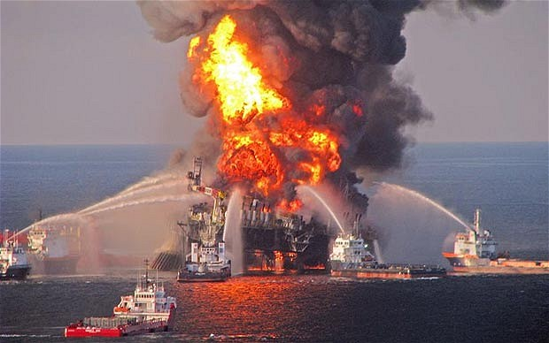
Volunteer deployment
Economic recovery and resiliency initiative began with Post Hurricane Katrina (2005-2008), followed by the Deepwater Horizon – Oil Spill and continuously after many disasters since that time
U.S. Economic Development Administration and its regional offices have been key partners, funding much of IEDC’s work, along with private donations from companies and individuals
Notes:
Volunteer Deployment to Build Capacity for Economic Recovery
IEDC prepares volunteers and connects them with local organizations
Travel and logistics covered
On-site support for minimum of one week
Long-term Recovery - technical assistance teams give advice and recommendations
IEDC prepares final reports & recommendations

Slide 5
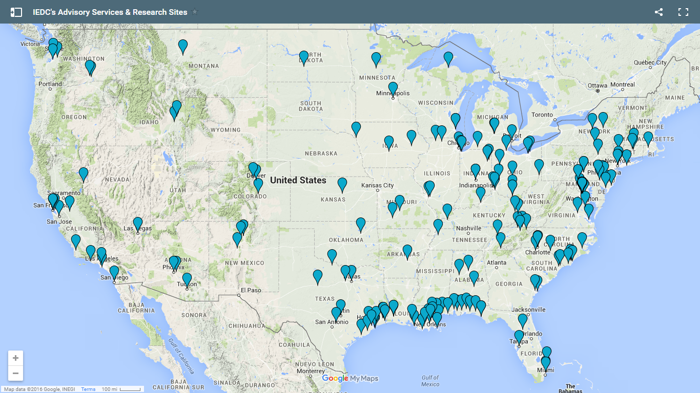
Volunteer locations since Katrina
This map is already out of date and shows only mainland U.S. locations prior to the 2017 hurricane deployments
Notes:
Since 2005, IEDC has delivered disaster preparedness and economic recovery support to American communities:
70+ technical assistance projects
50+ knowledge-sharing events
Webinars
Countless reports and papers
Federal partners:
US EDA
USDA Rural Devt.

Slide 6
Who are the volunteers?
Generally, economic developers who have experienced their own disasters or want to lend specific expertise to help others
Typically 10 - 40 years of experience – often at top management level
Many are Certified Economic Developers (CEcD) or business executives
Subject matter experts in disasters, issues, specific aspects of economic development:
Business retention
Entrepreneurship and small business issues
Economic development finance
Marketing and attraction of businesses, industries
Strategic economic development planning, comprehensive infrastructure planning
Revitalization, redevelopment of distressed areas
Workforce development and the wide range of issues this encompasses
Specific industries – from agriculture to tourism, advanced manufacturing, technology, etc.
Housing issues
How to use the wide range of federal and state programs after disasters

Slide 7
Overview of Economic Development

Slide 8
What is Economic Development?
A program, group of programs, or activities that seeks to improve the economic well-being and quality of life for a community by creating and/or retaining jobs that facilitate growth and provide a stable tax base.
The creation, retention, and expansion of jobs, development of the tax base, and enhancement of wealth.

Slide 9
An economically healthy community...
Has a sustainable tax base.
Meets needs with income.
Exports goods & services & imports cash.
Provides opportunities for personal growth.

Slide 10
Flexibility of “vision” – one that matches interests and assets of community
Strong understanding of local economy
Success factors of economic development leadership
Design programs around your community’s
comparative advantages
Stimulate co-operation

Slide 11
What you need to know
Your community’s economic strengths & weaknesses
Your community’s place in the regional economy
Your economic development vision and goals
Your strategies to attain these goals
How economic development is affected by local policies

Slide 12
And more…
Your regulatory environment
Your economic development stakeholders and partners
The needs of your business community & how you can help shape the business climate
Your community’s economic development message
Your resources for staffing economic development

Slide 13
Key Functions of Economic Development

Slide 14
Key function
Strategic Planning
Designing where economic development efforts will go
Documenting & implementing action plans

Slide 15
Key function
Marketing & Attraction
Building a positive community image
Using new marketing technology to attract attention to your community
Recruiting new industry and business
Working with site selectors
Closing deals to bring in new companies

Slide 16
Key function
Business Retention & Expansion (BRE)
Building relationships with existing companies
Assisting local business and industries to solve problems so they can stay in your community and grow
Keeping track of data about your businesses so you understand and can support positive trends

Slide 17
Key function
Entrepreneurial & Small Business Development
Strategies designed to assist small business
Programs that encourage new investment

Slide 18
Key function
Workforce Development
Programs to ensure that businesses have an adequate pipeline of skilled workers
How to encourage people in your community to prepare for the jobs your businesses are creating
Attracting and retaining talent in your community
How to use federal programs to meet your workforce objectives

Slide 19
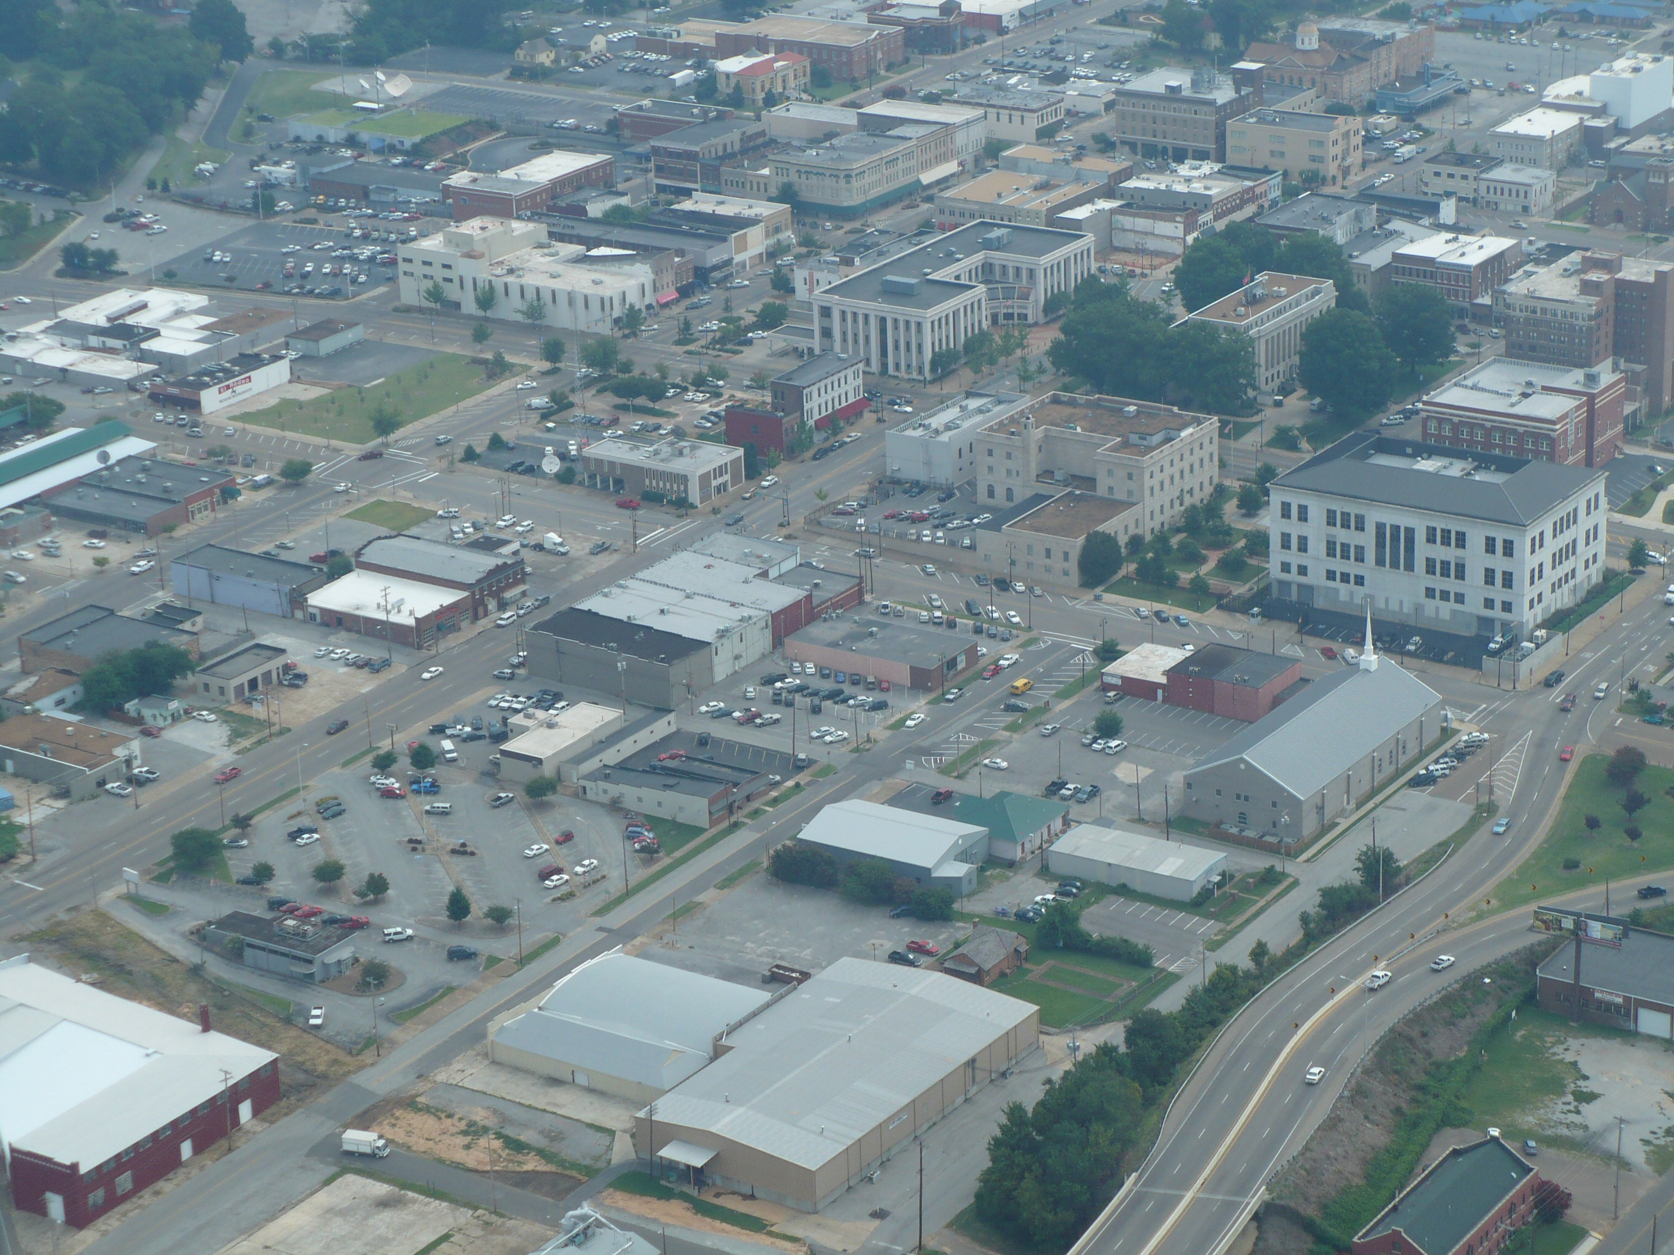
Key function
Real Estate Development and Reuse
Building new facilities
Using and rehabilitating existing buildings
Successfully dealing with contaminated properties

Slide 20
Key function
Economic Development Finance
Evaluating deals
Providing gap financing to enable good projects to move forward
How to use finance and loan programs to meet your development goals

Slide 21
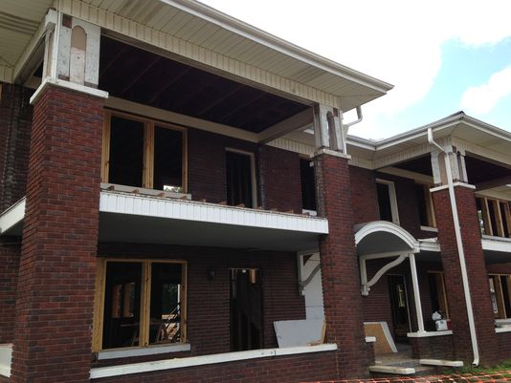
Key function
Neighborhood Development Strategies
Understanding the neighborhood economy
Tools to revitalize distressed communities that are struggling with vacant and blighted buildings

Slide 22
Key function
Economic Resiliency
How quickly your community can recover from natural or manmade crises
Programs you can put in place to help your businesses survive and people remain employed after an event
Long-term strategy: Is your economy diverse or solely dependent on one or two industries?

Slide 23
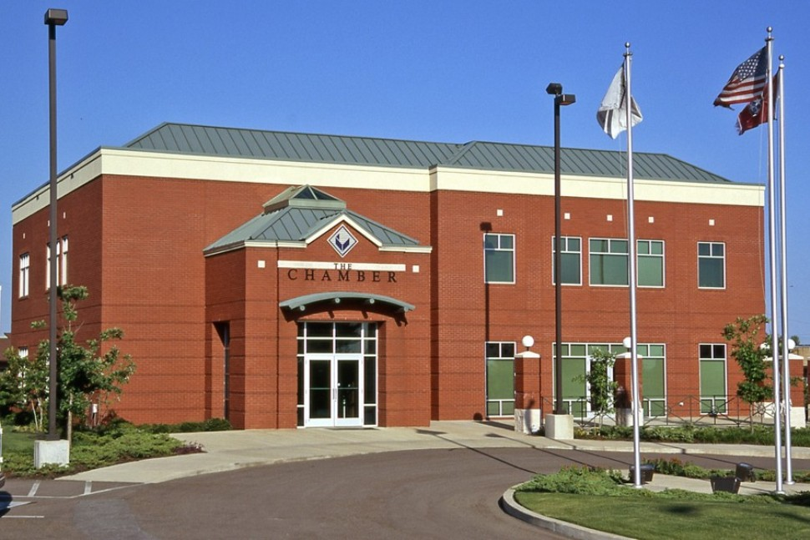
Who are your partners in economic development?
Chambers of commerce
Universities and community colleges
Industry associations
Neighborhood groups and residents
Utilities
Financial institutions
Federal, state, and regional economic development organizations
Notes:
Who are they? What are their names? (Do you like them ☺) You need partners to accomplish those key functions of economic development. What organizational resources do you have in your region?

Slide 24
Federal Government Resources
Department of Agriculture
Rural Business Cooperative Services
Office of Community Development
Economic Research Services
Department of Commerce
Economic Development Administration
Minority Business Development Agency
Trade Adjustment Assistance Centers (TAACS)
SelectUSA
Notes:
These are not just grants. The EDA for example, maintains a website called StatsAmerica, where you can get your community data and perform analysis on various aspects of your economy.
https://www.selectusa.gov/about-selectusa - SelectUSA is a U.S. government-wide program led by the U.S. Department of Commerce. Since its inception, SelectUSA has facilitated US$ 30.7 billion in investment, creating and/or retaining tens of thousands of U.S. jobs.

Slide 25
Federal Government Resources
Department of Housing and Urban Development
Community Development Block Grant Program
HUD Disaster Recovery
Small Business Administration
Numerous financial assistance programs
SBDC and technical assistance services

Slide 26
The Private Sector in ED
ROI: Must receive a return on investment
May assist with capital and technical assistance
May take an active or a silent investor role
May see community participation as a way to reduce risk
May partner when interests converge – such as workforce development or creating a healthy business climate

Slide 27
What local leaders need to know to champion ED
Understand the core functions of economic development
Know what successful economic development looks like and how to measure its effectiveness
Understand trends and how to respond
Bring local commitment to help transform communities and your economy
Notes:
Should also mention that they should know that political instability is a nightmare for investors.

Slide 28
Good leaders are ethical
An organizations ethical philosophy
Reputation
Productivity
Bottom line of the organization
If ethics are poor at the top, that behavior is copied down through the organization.
Robert Noyce
inventor of the silicon chip

Slide 29
Homework from this session: What is your ED “to do” list
Make sure there’s capacity and partnerships to perform economic development activities
What are your community’s assets and priorities for economic development?
What is your own role in economic recovery / economic development?
Questions?

